Slide 1


BookIT
Github Link - https://github.com/nihesh/BookIT
Classroom Booking Made Easy
FOUNDERS
NIHESH ANDERSON, sophomore, IIITD
HARSH PATHAK, sophomore, IIITD

Slide 2
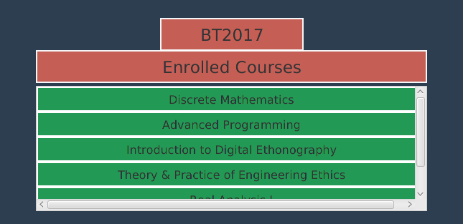
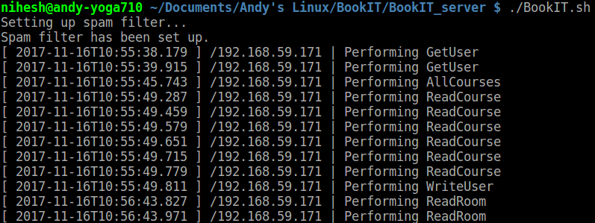
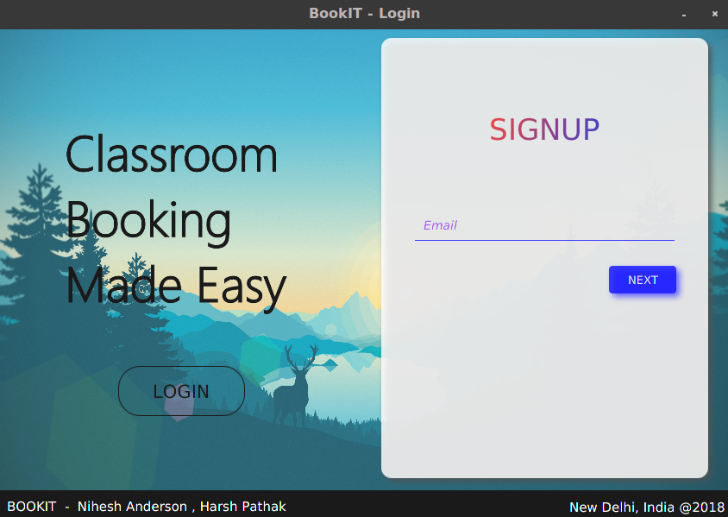
BookIT
Design Patterns
Observer Design Pattern
Faculty and student - Enroll into courses
Latest course state is accessed by the User Objects
Changes to course - Immediately reflected on Faculty and User
State Design Pattern
Server works differently in different states
The client sets server state and fetches required information
Ex: Read Course, Get User, Write User
Chain of Responsibility Design Pattern
Login/Signup - User goes through multiple validation stages
Each stage handles different aspects of Login/Signup
Ex: Entering email -> Entering password -> Login
Ex: Entering email -> pass and confirm pass -> Join Code, etc.
Other design patterns include Iterator and Singleton

Slide 3
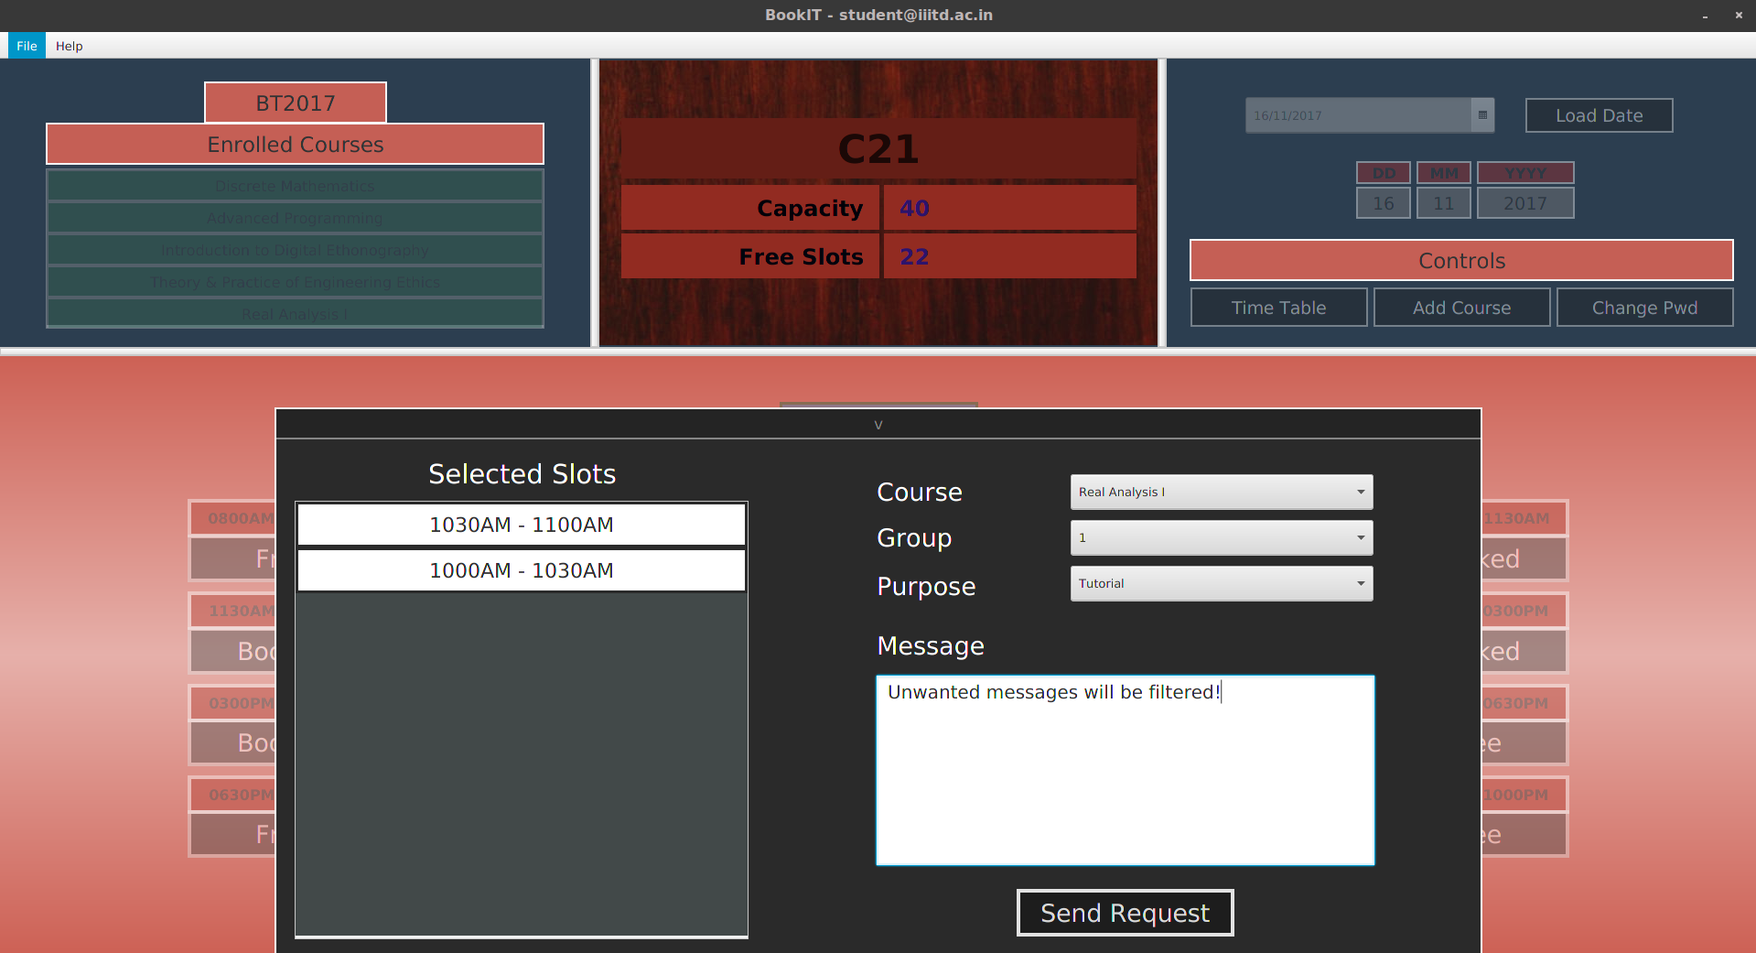
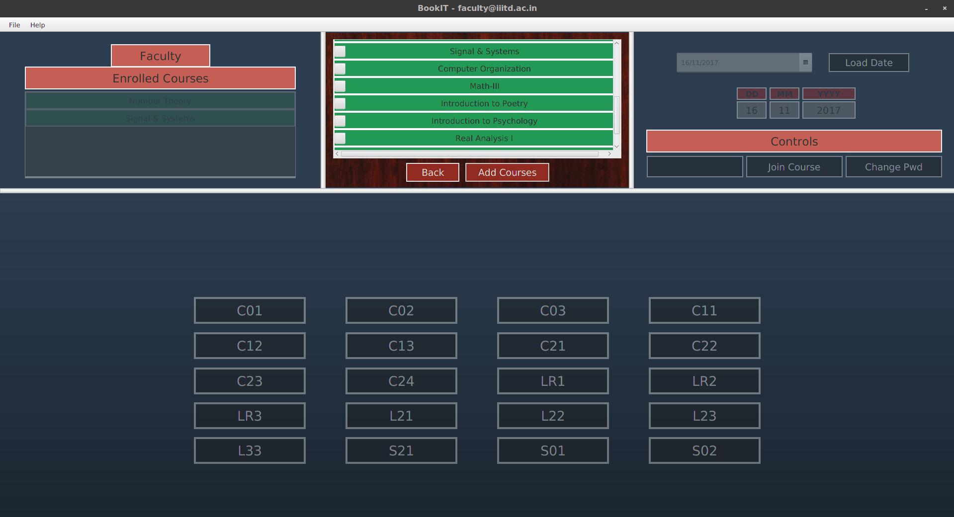
BookIT
Challenges
Getting the app to work on various platforms and on different screen resolutions.
Implementing networking based app so that multiple devices can access the app from a common server without conflicts.
Implementing spam filter on the app to identify spam messages during send requests with a high TPR (true positive rate)
Providing a generic model of the app which can be be easily extended at any time to support time table of other colleges if the project is scaled.
Coming up with a innovative GUI design and a proper logic of the working of the app in the given time.
Resolving minor bugs/glitches that could potentially have been misused to tamper the database

Slide 4
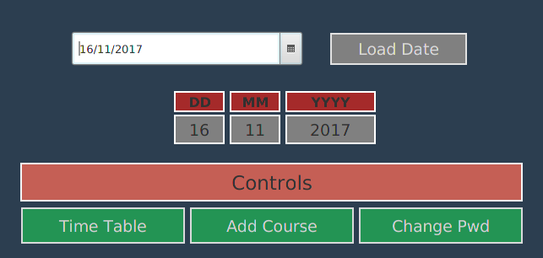
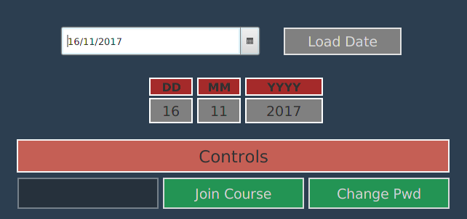
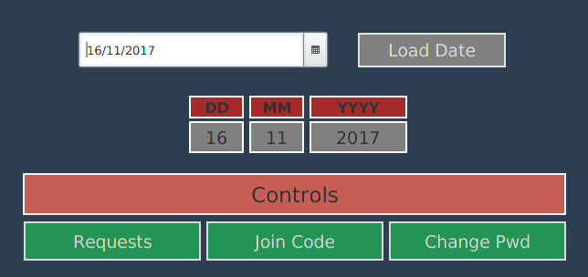
BookIT
Major Highlights
Networking based architecture - users can access the app from their devices anywhere in IIIT Delhi or using a VPN
Spam Filter - The app detects spam message requests and deletes them automatically, keeping the admins at ease.
Packaging - The project has been bundled into client JAR and server JAR for one click launch of the application. Documentation attached
Cross platform compatibility - The application works on both windows and linux platforms irrespective of the screen resolution of the target PC.
Innovative Design and GUI - The GUI of the app is different from what you normally see in a drag and drop made app in Scenebuilder. Easy to use interface
Change Password - Users can maximise the security by changing their passwords.
Joining Code facility - The additional join code generating facility allows admin to generate codes which then can be shared by the admin to prospective users. This prevents the app from being misused.
Student Controls
Faculty Controls
Admin Controls
Notes:
Let’s make everything and submit

Slide 5
BookIT
Distribution of work
Nihesh Anderson
Helper Classes - Room, Reservation, Course, SpamFilter, BookIT Constants.
GUI Classes - Student, Faculty and Admin GUI and their controllers.
Generated and parsed CSV timetable
Implemented SpamFilter using Naive Bayesian Classifier model.
Set-up server using socket programming.
Creating setup files for resetting server database
Implemented Automatic GUI scaling to suit screens with variable dimensions, on full screen mode.
Generated executable JAR for one click launch on windows and linux platforms with Oracle Java 8.
Tested the app, and fixed glitches/bugs.
Harsh Pathak
Helper Classes - User, Faculty, Student, Admin, Email, Logged Out Exception Class.
GUI Class - fxml + Controller
Created css files for the Login Signup GUI
Generated the app database for join codes, student requests, course postconditions, batch years, etc.
Created fxml files for Login Signup to fit different screen specifications.
Implemented joining code facility in admin class.
Added Change password functionality for all users.
Tested the app out for any glitches/ bugs.
Made the javadoc for classes in the App.

